Slide 1

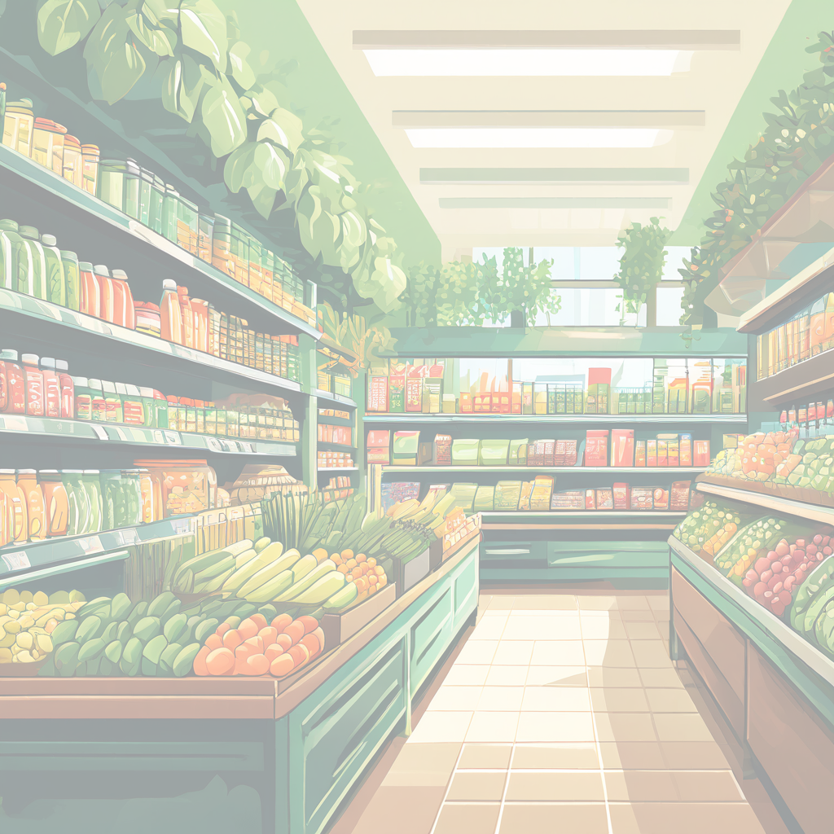

Slide 2

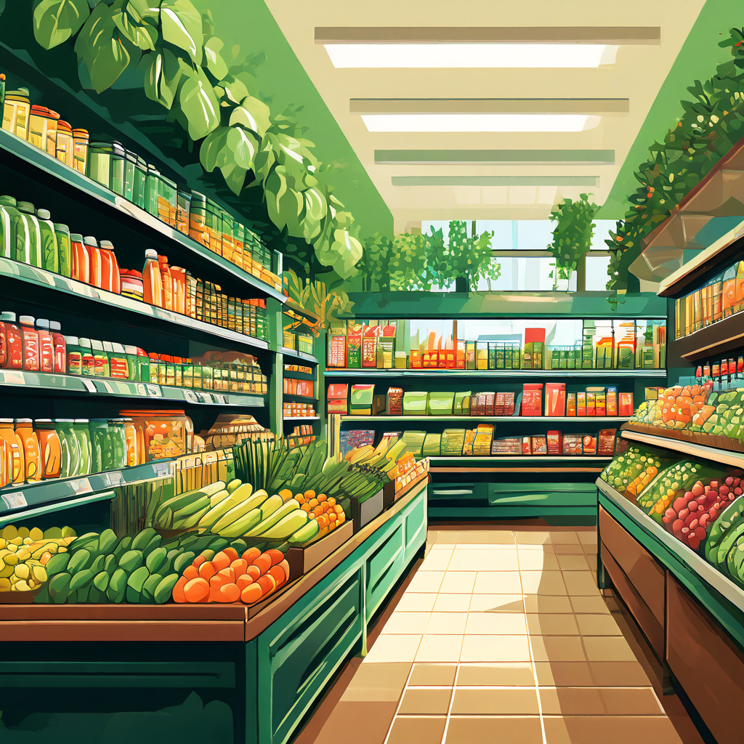
Introduction to "GROCERIA"
Revolutionize your grocery shopping experience with GROCERIA" - the one-stop app for all your fresh food needs."

Slide 3
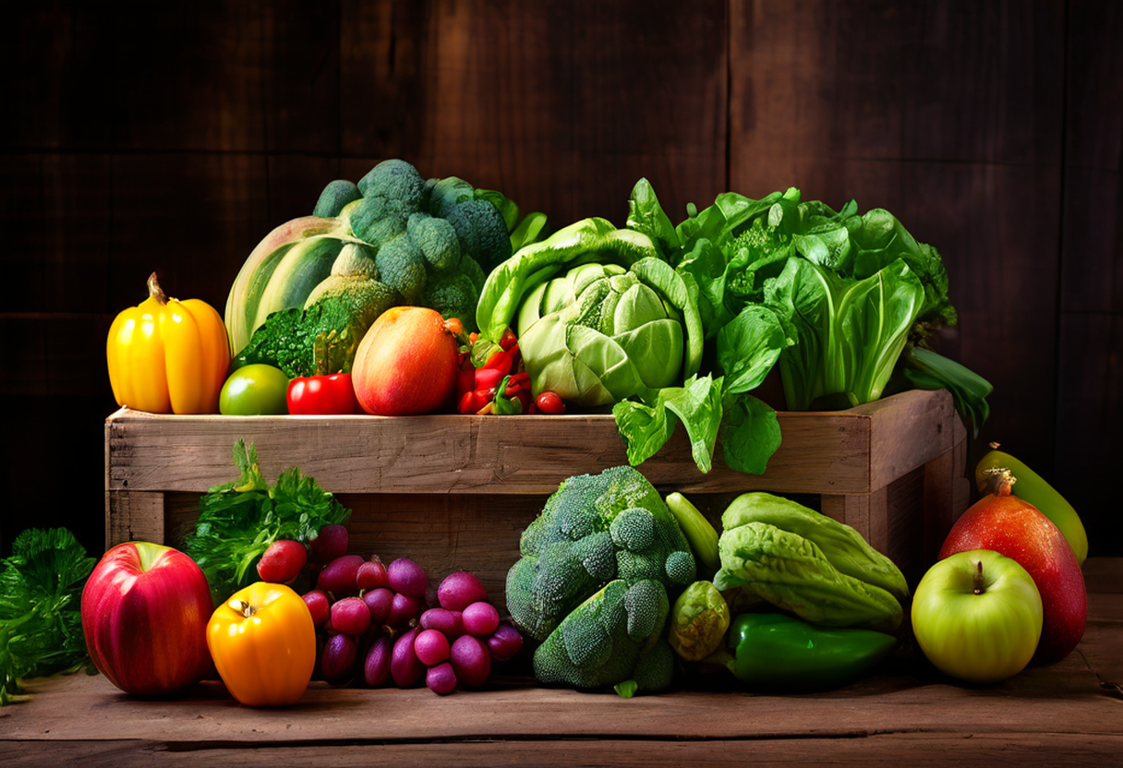

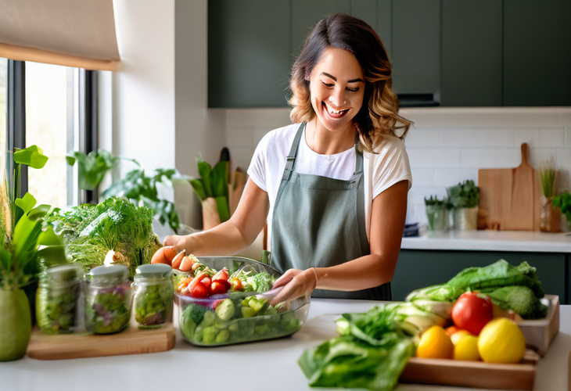
WHY GROCERIA ?
Farm Fresh Produce
We deliver the finest quality fruits and vegetables straight from local farms to your doorstep.
Convenient Delivery
With our reliable delivery service, getting your groceries has never been easier. We bring the farm to you!
Quality You Can Trust
Our commitment to freshness and sustainability ensures you receive only the best products for your family.

Slide 4

GROCERY SHOPING EXPERIENCE
BROWSE
Choose from wide variety of vegies , meats,and beverages,each categorically divided.
Add To Cart
Seamlessly add items to your cart with just a few taps
Checkout
Securely complete your purchase with various payment options.

Slide 5

FEATURES
IN
GROCERIA

Slide 6
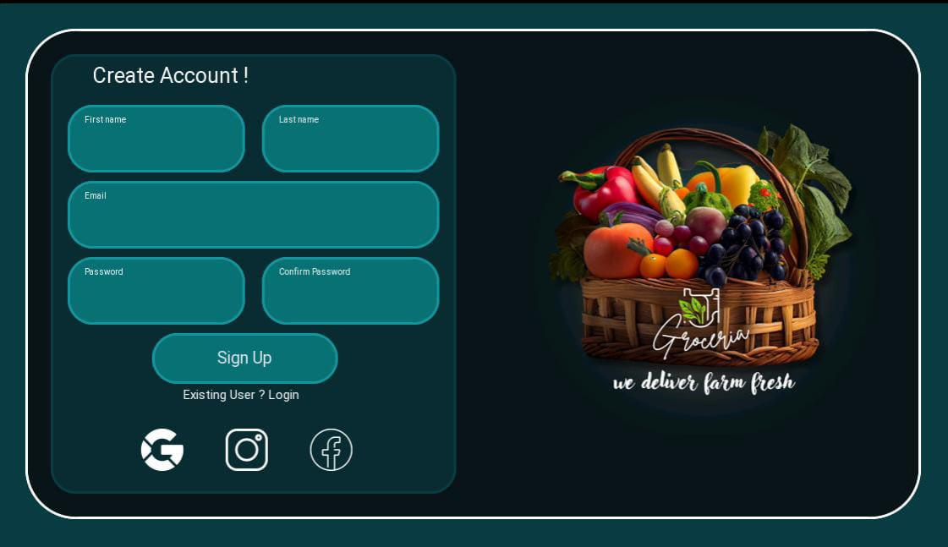
Sign Up Page
New users can sign up for a Groceria account by providing their basic information, including name, email, and password. This creates a secure profile to manage their grocery orders.

Slide 7
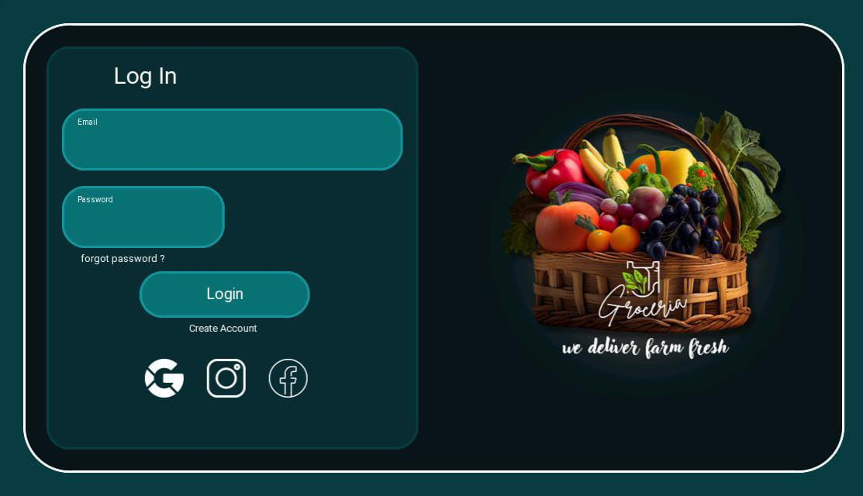
Login Page
Registered users can log in to their Groceria account using their email and password. This grants them access to their personalized shopping history and preferences.

Slide 8
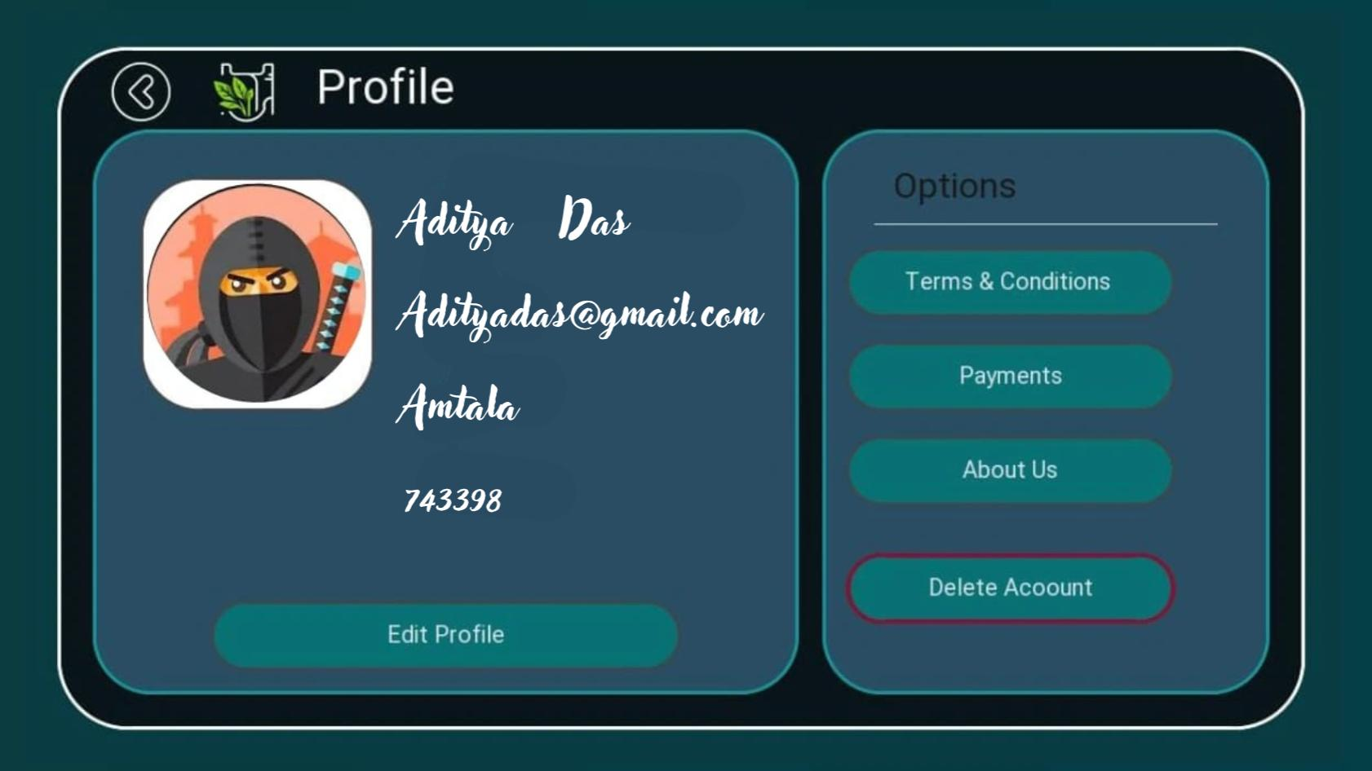

User Profile
Laddu
mutyanand
laddumutya@gmail.com
Maharja Colony , babasignpur,
875467

Slide 9
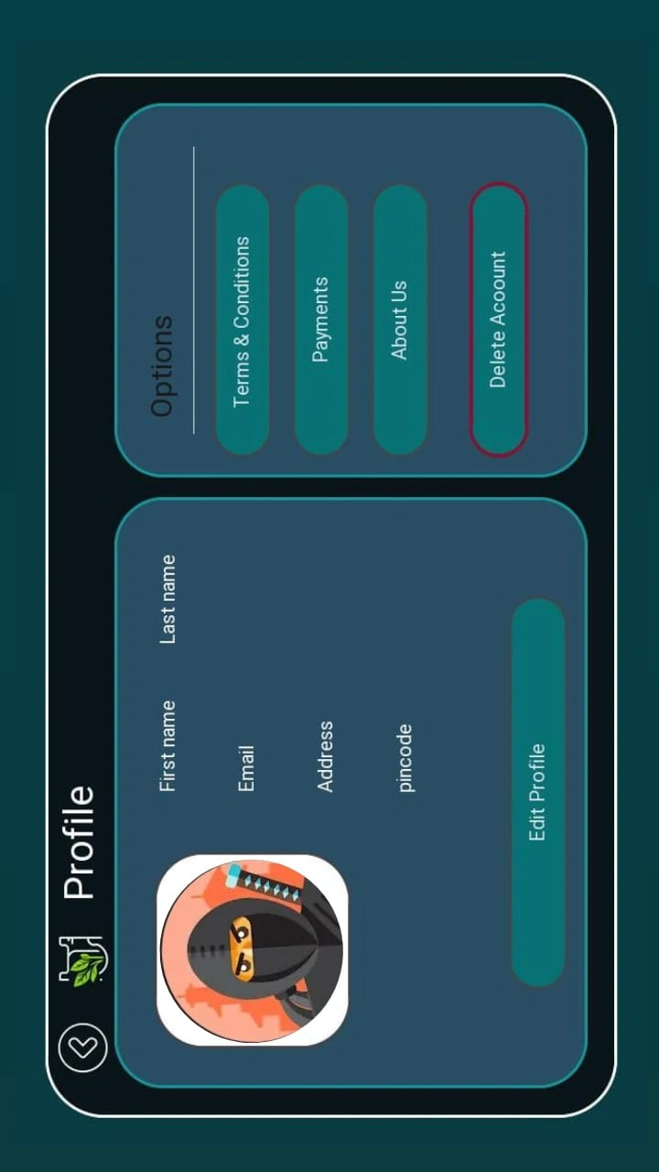
Delete Profile
They can also delete their account if they wish

Slide 10
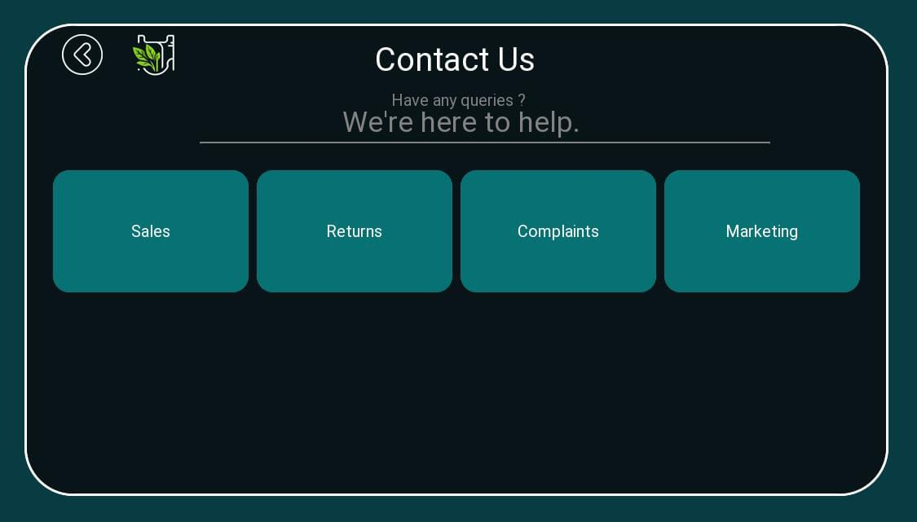
Contact Us Page

Slide 11
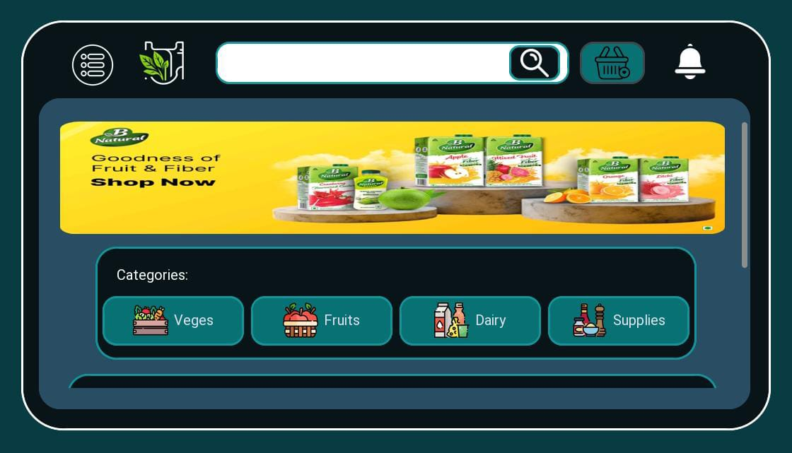
User Interface Design
Intuitive Navigation
Seamless user flow and clear categories for easy browsing

Slide 12
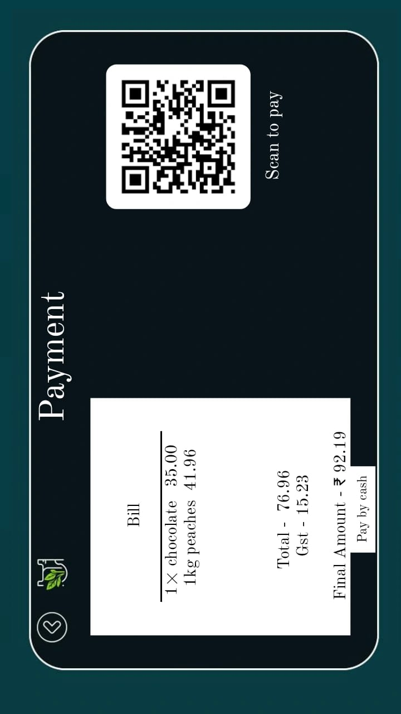
Streamlined Checkout
OR
Simplified process to complete purchases efficiently.

Slide 13
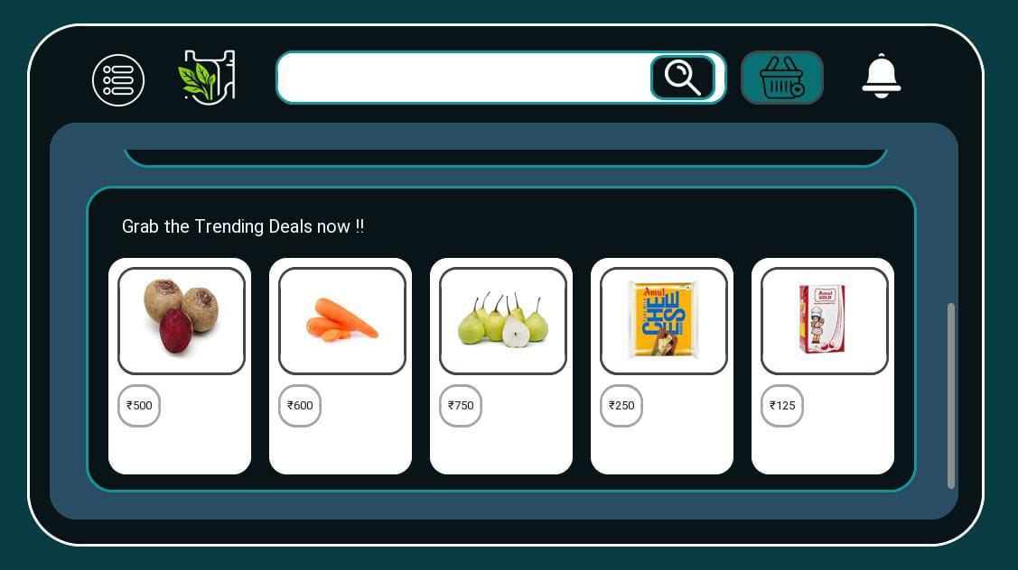
GET THE TRENDING DEALS
₹120/kg
₹53/kg
₹70/kg
₹35
₹20

Slide 14
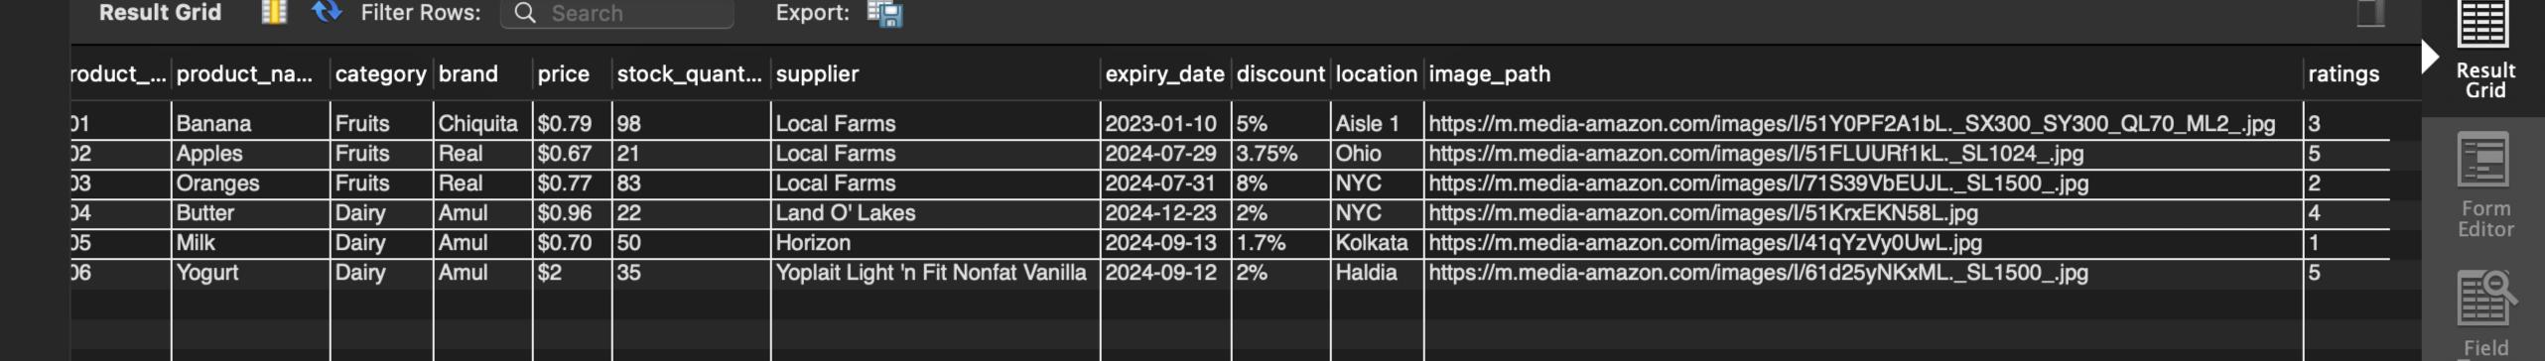
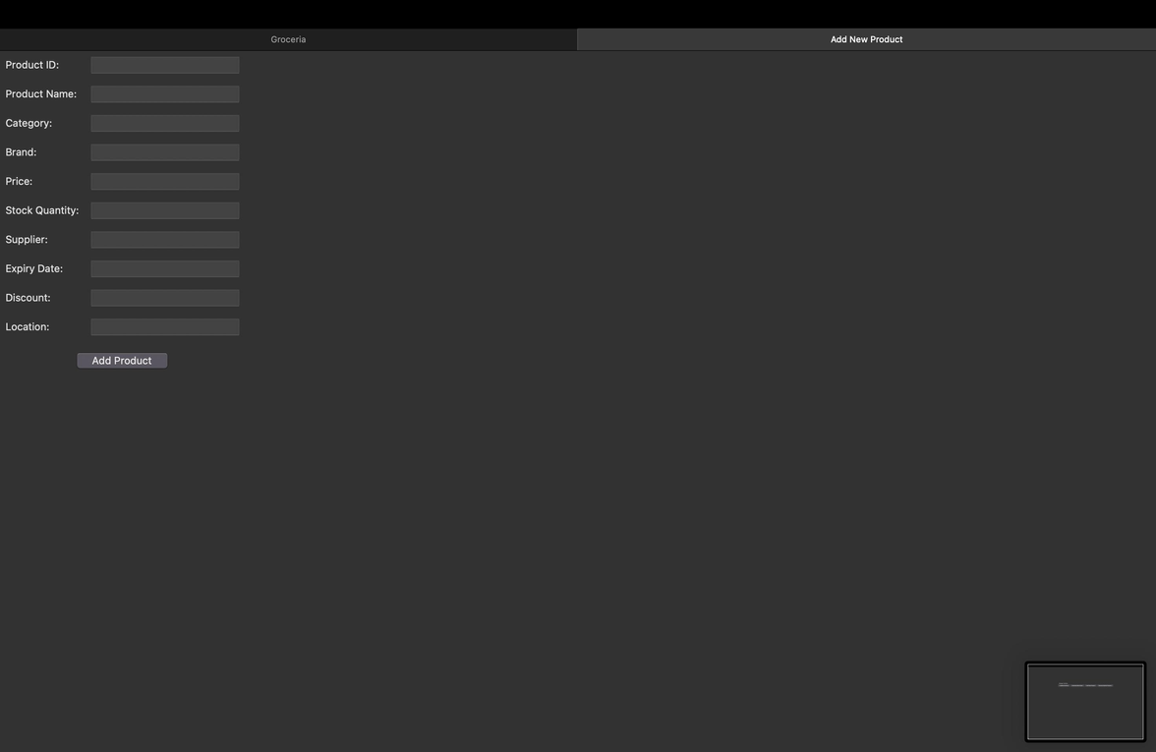
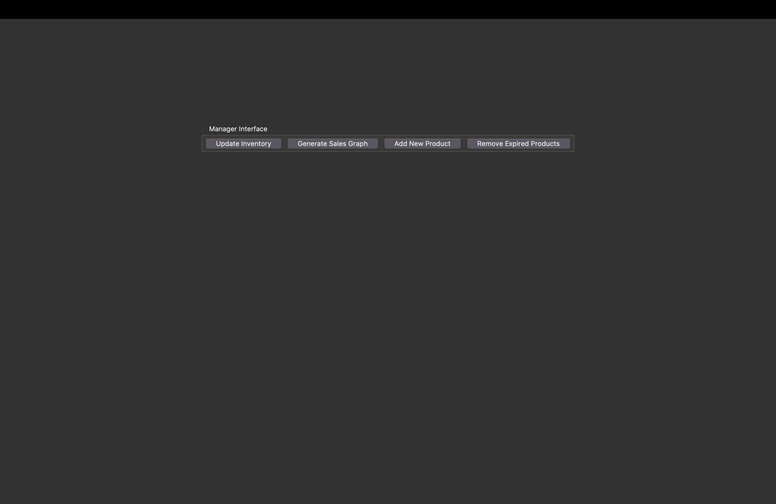
Glipses Into the Database

Slide 15
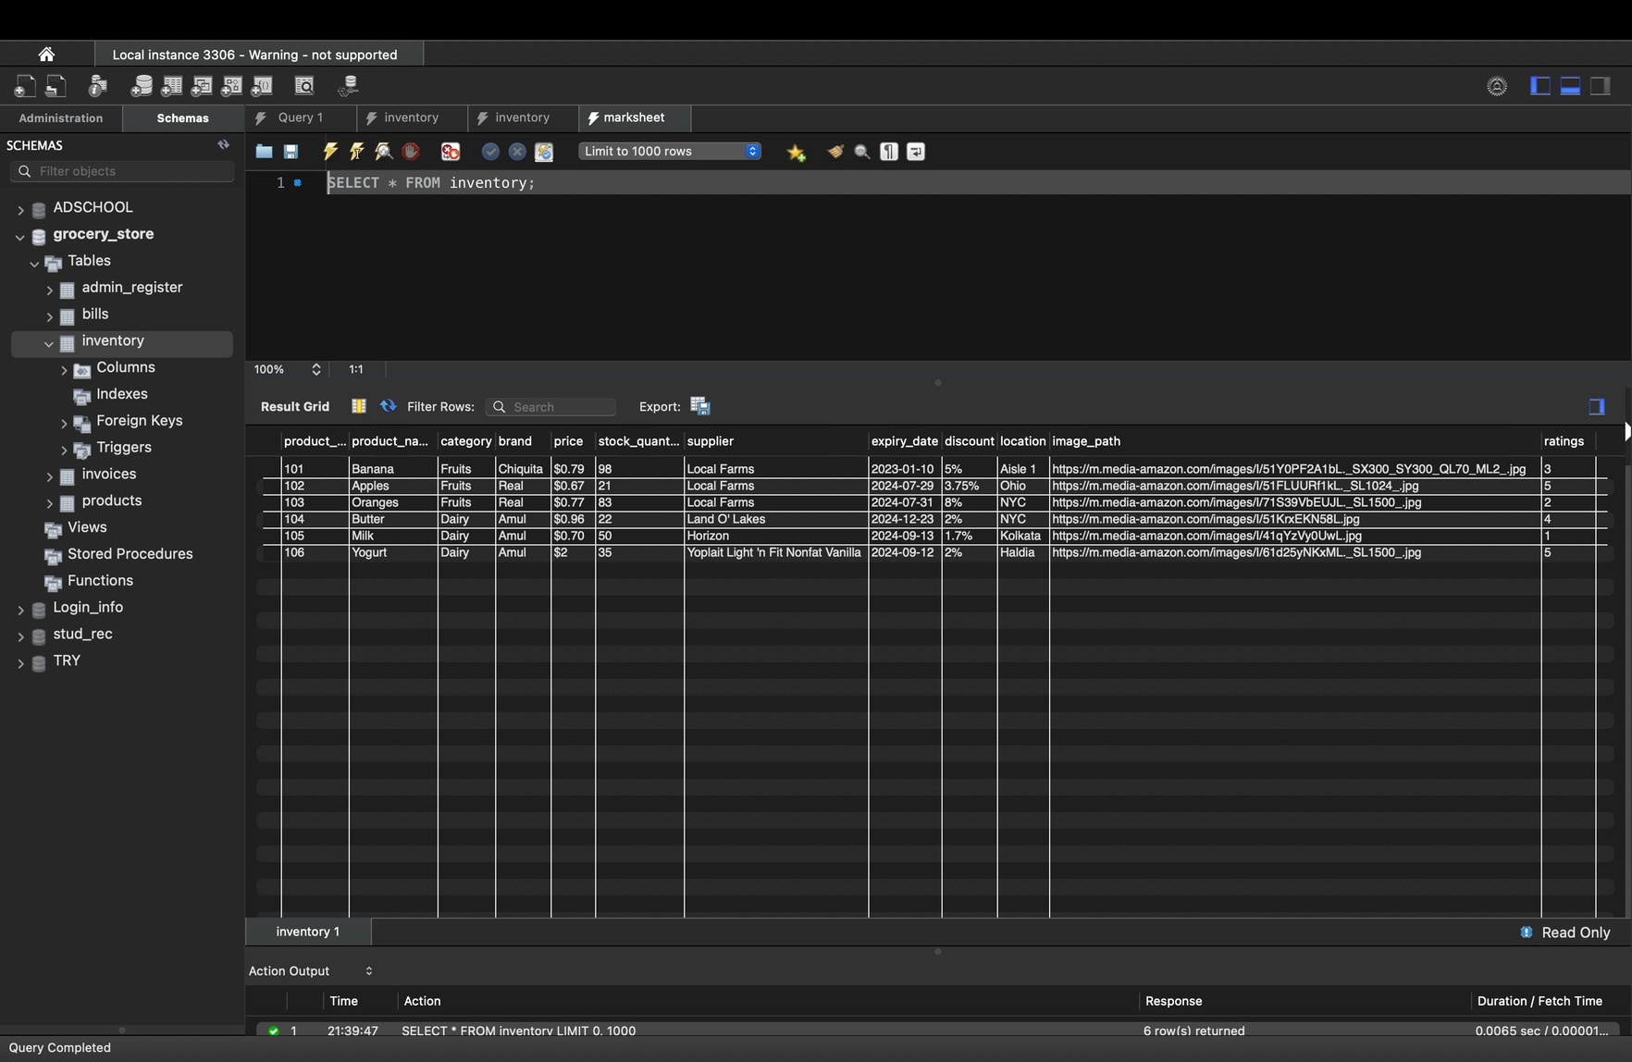
Glipses Into the Database

Slide 16
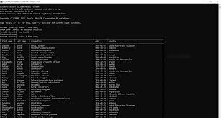
Glipses Into the Database

Slide 17


Sofware and Resources used
Front-end Development
PYTHON
Back-end Development
MySQL

Slide 18



LIBRARIES USED
MYSQL
CONNECTOR
CUSTOM TIKINTER
PILLOW

Slide 19
DEVELOPED BY
LEADER Aditya Das (Front end & Backend)
COLEADER SUMAN DAS(Complete Presentation)
Ashok Kumar (Front end & backend)
Mayank Dubey(Documentation)
Ariyan Kumar Gupta (Documentation & Logo design)

Slide 20
Scope Of Improvement
Better User Interface
More Features
More Payment Option

Slide 21
THANK YOU!
Have a great day ahead.

